Slide 1

Physical Security
RFID Hacking

Slide 2
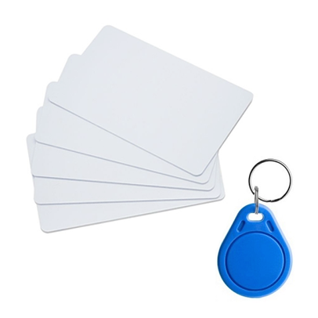
What is RFID
RFID stands for Radio Frequency Identification.
It is a technology that uses radio waves to wirelessly identify and track objects.
RFID tags consist of a microchip and an antenna, allowing them to transmit and receive data.

Slide 3
How it works?
RFID works by using a reader and an antenna that emit radio waves to communicate with a tag.
The RFID reader emits a radio signal
The RFID tag’s antenna detect the radio signal and converts it into electrical energy.
The RFID tag’s chip uses the electrical energy to power up and transmit its data back to the RFID reader.
The RFID reader’s antenna receives the data from the RFID tag and decodes it.
The RFID reader then sends the decoded data to a computer or other device for processing.

Slide 4
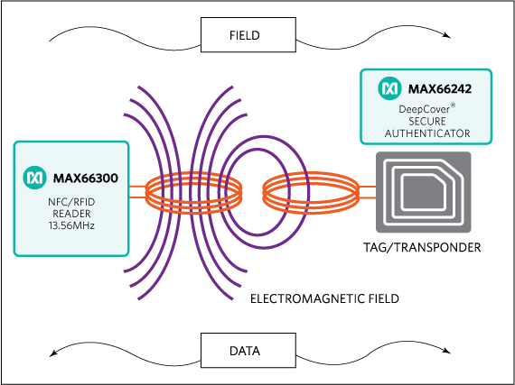
Cont…

Slide 5
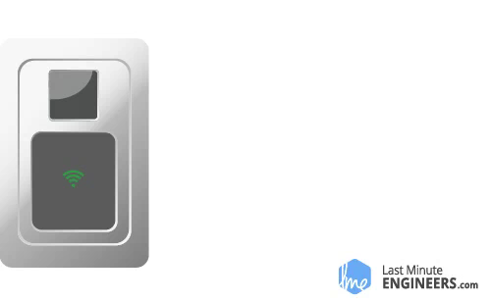
Cont…

Slide 6
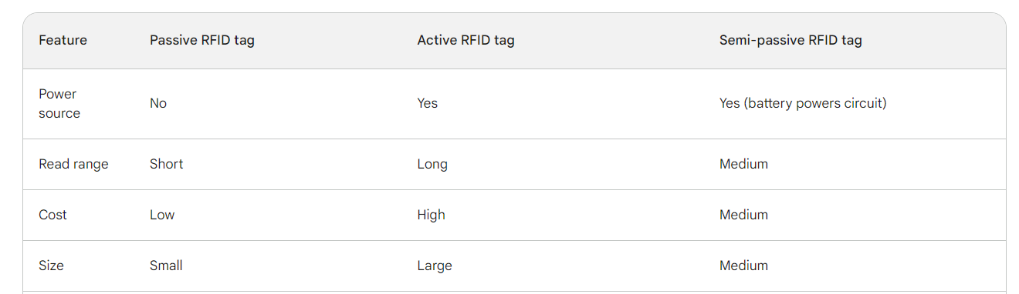
Types

Slide 7


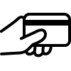
Use Cases
Access Control
Inventory System
Contactless Payment
RFID tags are commonly used in :
RFID cards can be used to control access to buildings, rooms, and other secure areas.
RFID tags can be attached to products to track inventory levels and prevent theft
Transit fare payment cards and electronic toll collection

Slide 8
RFID Vulnerabilities
SECURITY
Despite its convenience, RFID technology has vulnerabilities that can be exploited by hackers.
Eavesdropping
Cloning
Denial of service
are some of the common threats.
By intercepting and manipulating RFID signals, attackers can gain unauthorized access, clone RFID tags, or disrupt the functionality of RFID systems.

Slide 9
RFID Cloning
How to copy RFID Access Cards

Slide 10
RFID Cloning
On this presentation we will be looking at RFID card with 1KB of memory
Memory layout of 1KB tag
16 sectors ( 0 to 15)
Each sector has 4 blocks ( 0 to 3)
Each block can store 16 bytes of data (0 to 15)
The Block 0 of Sector 0 is known as Manufacturer Block which contains the manufacturer data and the card UID
16 sectors x 4 blocks x 16 bytes = 1024

Slide 11
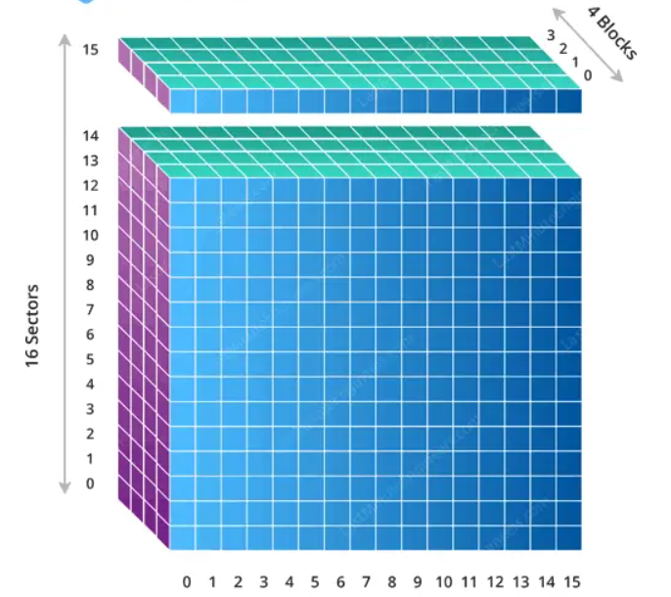
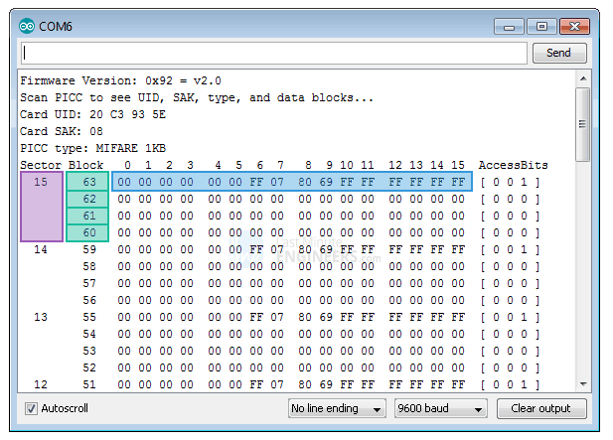
Cont…

Slide 12
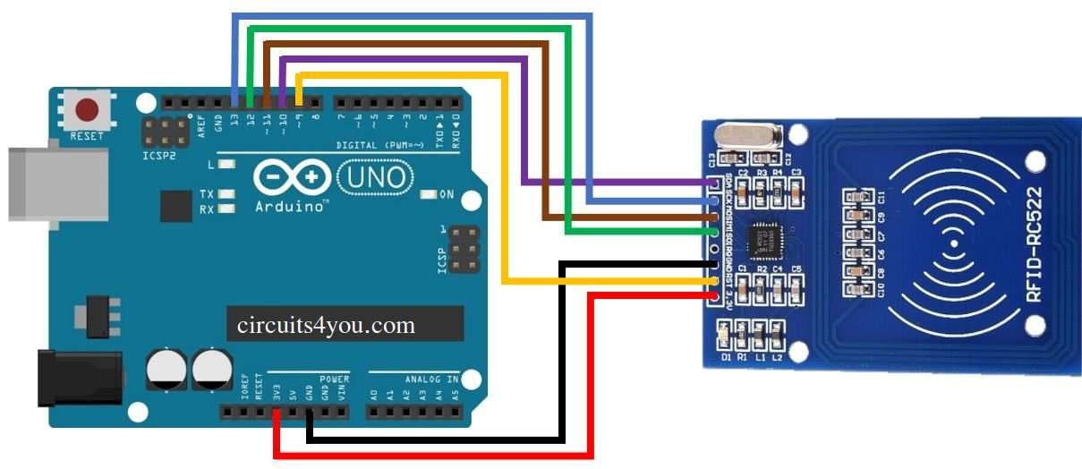
Tools
Arduino Board
RFID card reader – RC522 (13.56 MHz)
Sector 0 writeable RFID cards
NFC enabled Mobile Phone

Slide 13
Demo

Slide 14
Possible Solutions
Use more than one key to unlock a door
Use Encryption enabled cards and readers
Use RFID card reader Protection

Slide 15
The End
Thank You
የቆሎ ተማሪ
“Sometimes, You Have To Demo A Threat To Spark A Solution!”
Barnaby Jack, 1977-2013
Nov 11, 2023

